Slide 2
The Problem

Slide 3
x
The Problem
x
Takeaways
What is the problem with using current methods?
Why are people not using quantitative methods?

Slide 4
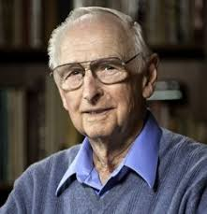
The Problem
x
Do “Scores” and “Scales” Work?
Researchers uncovered several unintended consequences of simple ordinal scales and using words for probabilities
David Budescu and Dick Heuer (separately) Researched the “illusion of communication” regarding interpretations of verbal labels for probabilities
10% 20% 30% 40% 50% 60% 70% 80% 90%
Craig R. Fox showed how arbitrary features of how scales are partitioned effects responses.
Example:
If “1” on a 5-point impact scale means “less than $1 million loss”, the share of that response is affected by the partition of other choices.

Slide 5
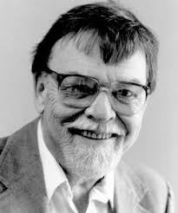
The Problem
x
Expert vs. Quantitative Models
“It is impossible to find any domain in which humans
clearly outperformed crude extrapolation algorithms,
less still sophisticated statistical ones.”
“When you can hardly come up with a half dozen studies
showing even a weak tendency in favor of the clinician,
it is time to draw a practical conclusion.”
Philip Tetlock
Paul Meehl

Slide 6
The Problem
x
Why Don’t We Use More Quantitative Methods?
Have you heard (or said) any of these?
“We don’t have sufficient data…”
“There is too much error and bias in the data
for it to be worth the effort to gather it...”
“Each situation is too unique and complex to
apply scientific analysis of historical data...”
“There are so many factors affecting this;
this measurement alone tells us nothing...”
The implied (and unjustified) conclusion from each of these is….
“…therefore we are better off relying on our experience.”

Slide 7
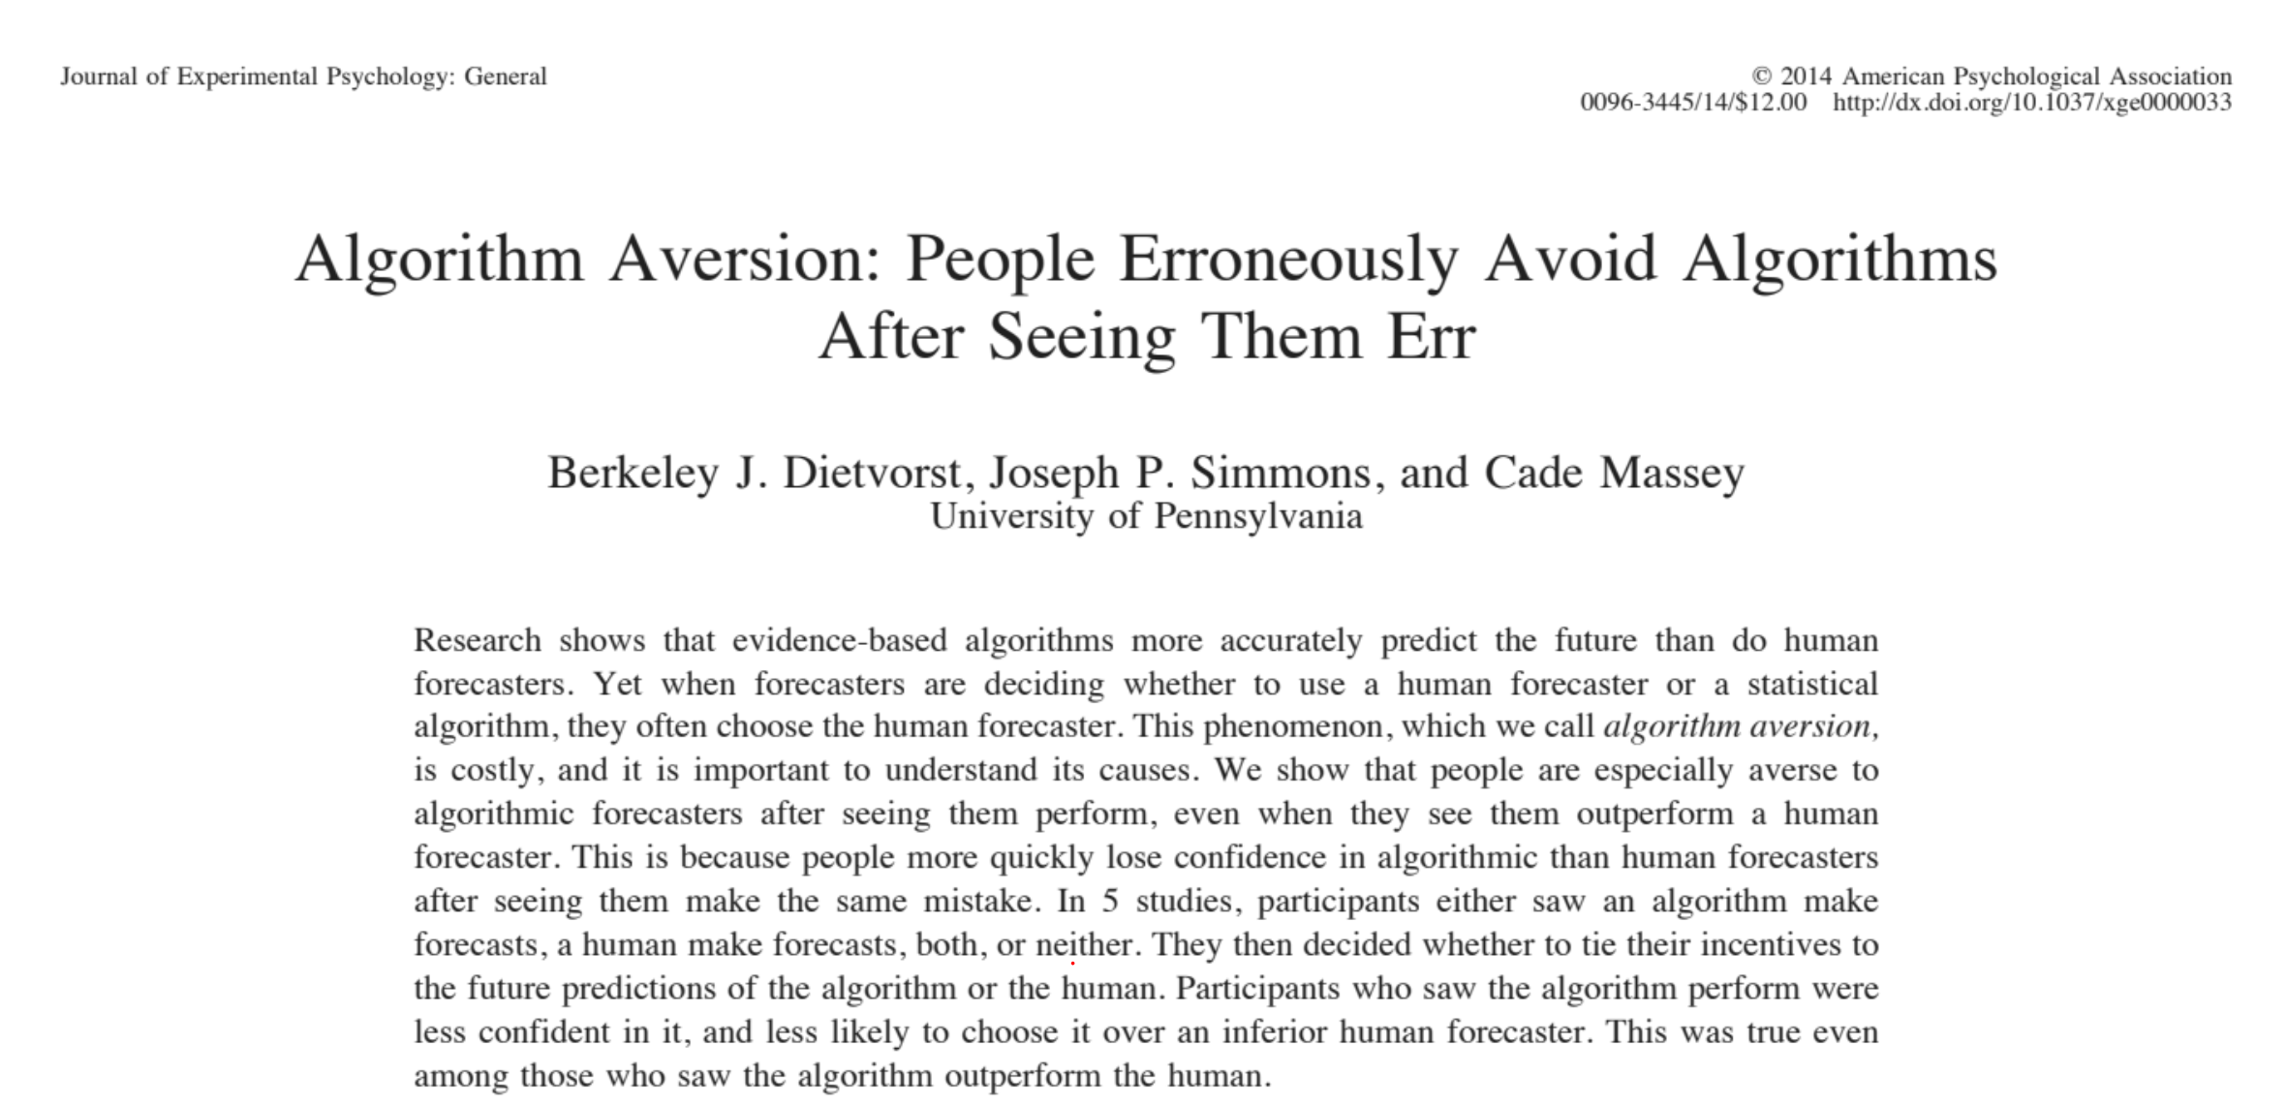
The Problem
x
Aversion to Algorithms
There is a double standard when evaluating algorithms vs. human experts.
Research shows that even when algorithms perform better than a human expert overall, people penalize the algorithm for an error more than the human.
Don’t make the classic “Beat the Bear” fallacy.
Exsupero Ursus

Slide 8
The Problem
x
The Problem and The Solution
Applied Information Economics was developed to address these issues.

Slide 9
The Problem
x
End of Part 2
Please take Quiz 2 before continuing.

